Slide 1
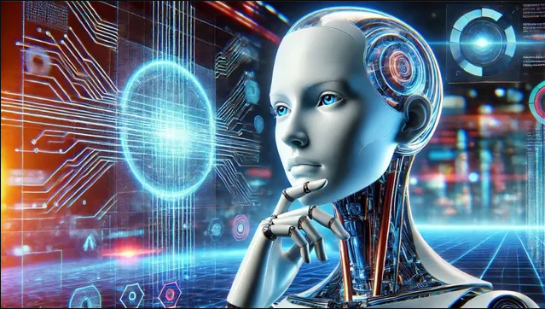

Generative AI Shaping The Future With Intelligence
OMKAR N

Slide 2
Name: Omakr Nallagoni
Company: Cognizant
Client : Google
Experience: 12 Years
Designation: Lead Data scientist
MTech : JNTU Hyderabad
PG Diploma in Data Science : IIT Tirupati.
Lead Data science trainer at Naresh IT
Data Science SME at Naresh IT
Azure Data science Certified
GCP ML Engineer Certified
Collaborated with Praxis Business school, Brillo, Bhartiya Vidhya Peet, UpGrade, Spjain, IMS Pro school
https://www.linkedin.com/in/nallagoni-omkar-783271188/

Slide 3
Will show some Pictures now
Picture-1:
What is your thoughts on above picture ?

Slide 4

Picture-2:
What is your thoughts on above picture ?

Slide 5
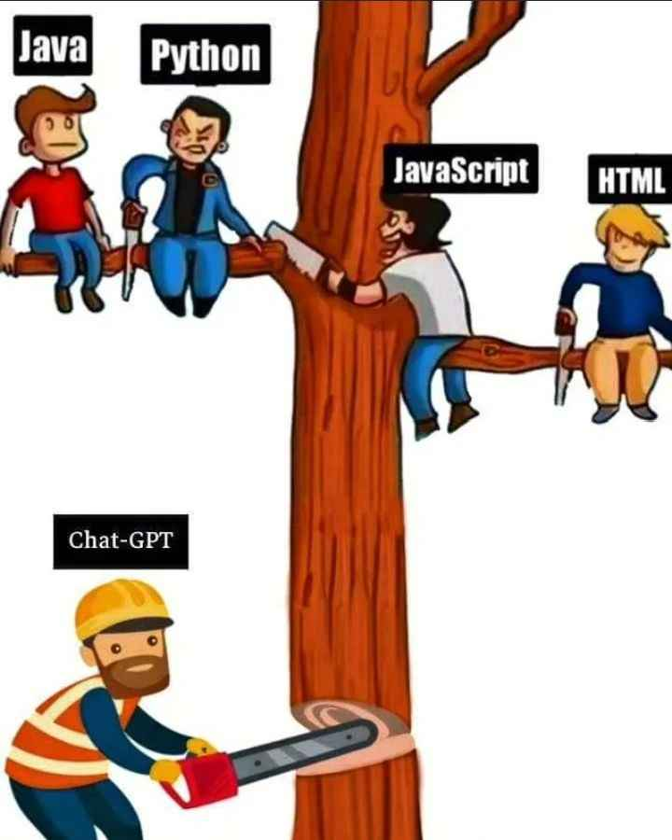
Picture-3
What is your thoughts on above picture ?

Slide 6
Generative AI

Slide 7

Generative AI
Write a tagline for an ice cream shop
I’m having trouble getting
my Ybox to turn on.
Table customers, columns=[CustomerId,FirstNAme,LasrName,Company,Address,City,State,Country,PostalCode]
Create a SQL query for all customers in Texas names jane query=
A ball of fire with vibrant colours to show the speed of innovation at our media and entertainment company
Prompt
Prompt
Prompt
Prompt
Response
We serve up smiles with every scoop!
Response
There are a few things you can try to troubleshoot this issue - -
Response
Response
SELECT * FROM Customers WHERE State=‘TX’ AND FirstName=‘Jane’
Thanks! That worked. What games do you recommend for
my 14-year-old?
Prompt
Response
Here are a few games that you might consider: -

Slide 8
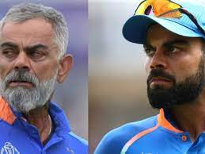
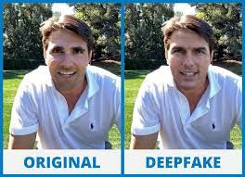

Slide 9
Large Language Model

Slide 10
LLM (Large Language Model)
LLMs are AI systems trained on Massive amount of text datasets to generate human-like responses.
Example:
User: 'Tell me about quantum physics.'
AI: 'Quantum physics studies particles at microscopic scales...'
Mistake: Without proper prompts, AI may generate incorrect or vague information.
Solution: Use precise prompts to get better responses.

Slide 11
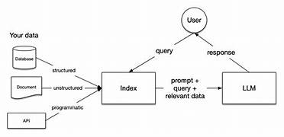
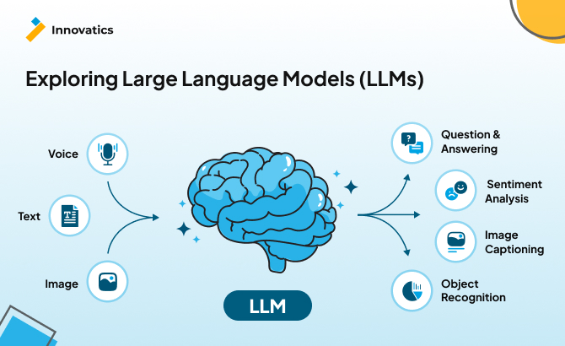
Importance of LLMs
Saves Time & Effort – Automates work, increasing efficiency.
Enhances Communication – Translates languages and improves accessibility.
Boosts Innovation – Helps in research, coding, and creative writing.
Improves Decision-Making – Analyzes data and provides insights.

Slide 12
Transformers
A Transformer is a type of deep learning model used in Natural Language Processing (NLP) and other AI tasks. It processes and understands data by focusing on important parts of the input using a mechanism called "attention."
Neural networks that use self-attention to process sequential data.
Example:
Transformers power ChatGPT, BERT, and T5 models for language understanding.
Mistake: Without enough training data, transformers may struggle with context.
Solution: Train on diverse datasets for better understanding.

Slide 13
Prompt Engineering
The art of designing inputs to guide AI for optimal responses.
Example:
Prompt: "What is 24 × 5?" ✅ AI Response: "120“
Mistake: Vague prompts lead to irrelevant or overly broad answers.
Solution: Be specific and structured.
Basic Prompt: "Write about climate change.“
Optimized Prompt: "Write a 300-word article on the effects of climate change on agriculture, with examples from different continents."

Slide 14
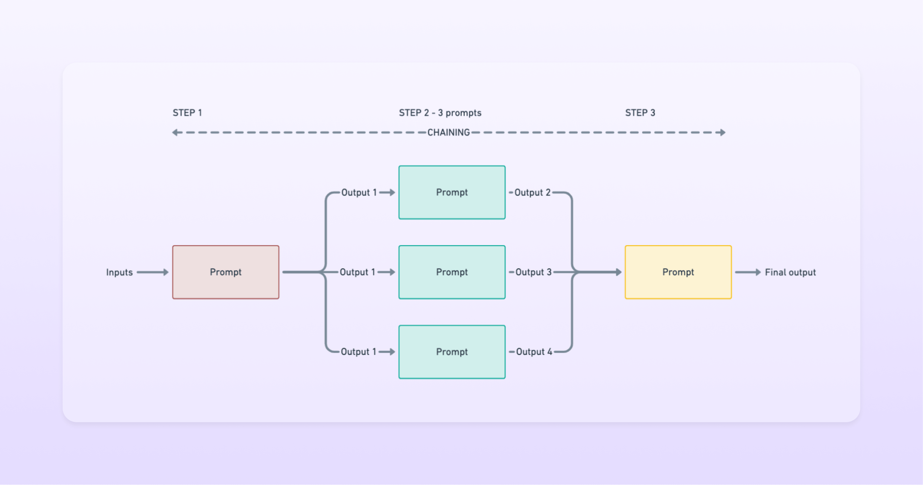

Slide 15
Chain of Thought
Chain of Thought (CoT) is a reasoning technique used in artificial intelligence (AI) and natural language processing (NLP) where an AI model is encouraged to break down complex problems into smaller, logical steps. Instead of providing a direct answer, CoT allows the model to think step by step, improving its reasoning capabilities.
Breaking complex problems into logical steps for better reasoning.
Mistake: Direct answers may lack clarity.
Solution: Guide the model through step-by-step reasoning.

Slide 16
NORMAL PROMPT | CHAIN OF THOUGHT PROMPT
Normal Prompt: Q: The cafeteria had 23 apples. If they used 20 to make lunch and bought 6 more. How many apples do they have? AI Response: 9 apples. | Chain of thought Prompt: Q: Roger has 5 tennis balls. He buys 2 more cans of tennis balls. How many tennis balls does he have now? A: Roger started with 5balls. 2cans of 3 tennis balls each is 6 tennis balls. 5+6=11 Q: The cafeteria had 23 apples. If they used 20 to make lunch and bought 6 more. How many apples do they have? AI Response: A: The cafeteria had 23 apples originally. They used 20 to make lunch. So they had 23-20=3. they bought 6 more apples. So they have 3+6=9. The answer is 9.

Slide 17
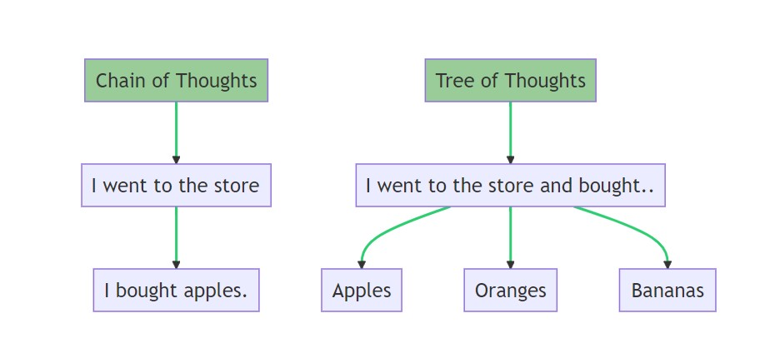

Slide 18
Zero-Shot Learning
ZSL enables a model to generalize knowledge from known classes to unseen ones using auxiliary information, such as descriptions, attributes, or semantic embeddings.
AI generates responses without prior examples.
Example:
Prompt: "Solve 24 × 5." ✅ AI Response: "120."
Mistake: May produce incorrect results without examples.
Solution: Use clear instructions or provide few-shot examples.

Slide 19
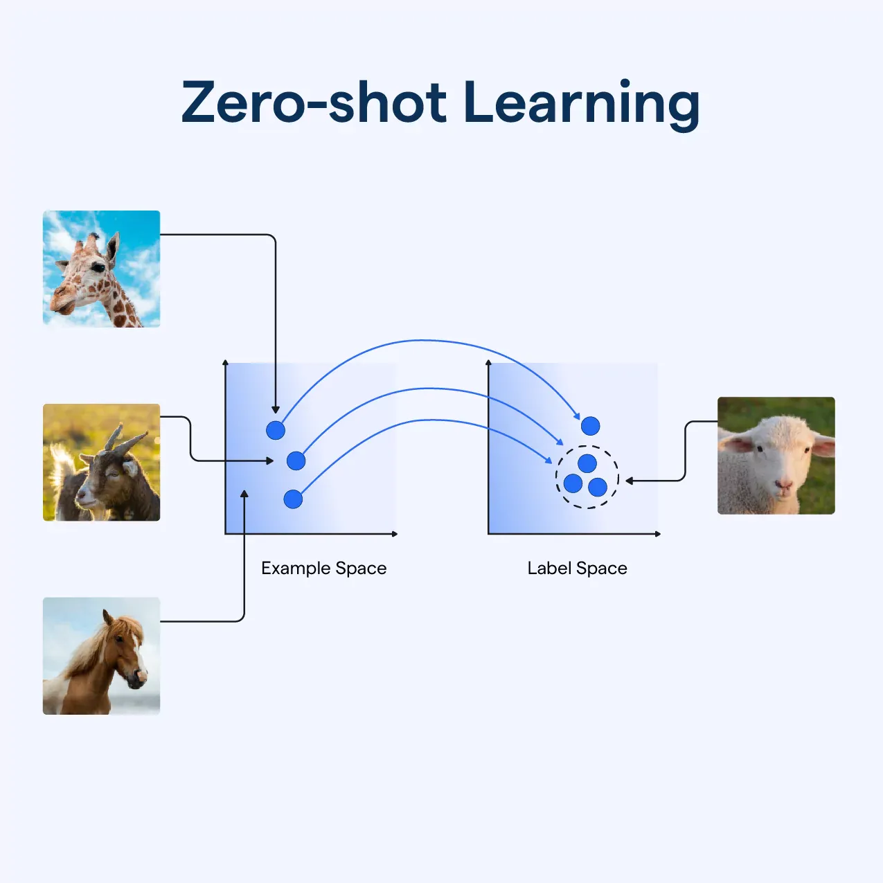

Slide 20
Few-Shot Learning
Few-Shot Learning (FSL) is a machine learning approach that enables a model to make accurate predictions with very few training examples per class. Unlike traditional deep learning, which requires large amounts of labeled data, FSL allows models to generalize from a small number of examples, often leveraging prior knowledge.
Providing examples before asking AI to generate output.
Example:
Prompt: Example 1: 12 × 5 = 60 Example 2: 16 × 5 = 80 Now solve 24 × 5. ✅ AI Response: "24 × 5 = 120."
Mistake: Without examples, the model might guess incorrectly.
Solution: Providing examples improves accuracy.

Slide 21
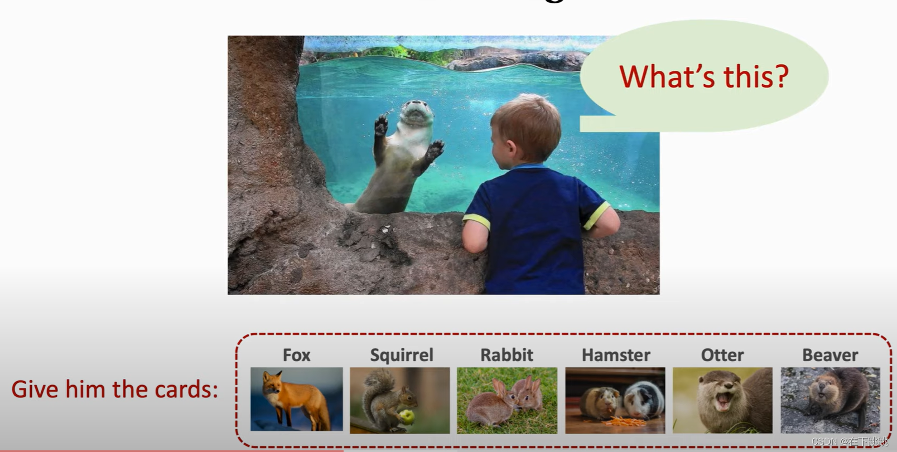

Slide 22
Hallucinations
Hallucinations are sensory experiences that appear real but are created by the mind.
When AI generates false or misleading information.
Example:
Prompt: Asking for the Capital of France
AI Response:
"The capital of France is Paris. Paris is known as the ‘City of Light’ and is famous for landmarks like the Eiffel Tower, the Louvre, and Notre-Dame. It has a rich history dating back to Roman times and is also a global center for fashion, art, and culture."
Mistake: AI sometimes generates plausible but incorrect facts.
Solution: Verify with external sources and fact-checking.

Slide 23
Temperature
In Generative AI, temperature is a hyperparameter that controls the randomness of the model’s output. It affects the probability distribution of the next word (or token) in text generation.
Controls randomness in AI responses.
Example:
Prompt: Asking for the Capital of France
AI Response: (Lower Temperature = 0.2)
"The capital of France is Paris."
Mistake: High temperature may generate overly creative or inaccurate responses.
Solution: Adjust temperature based on desired response style.

Slide 24
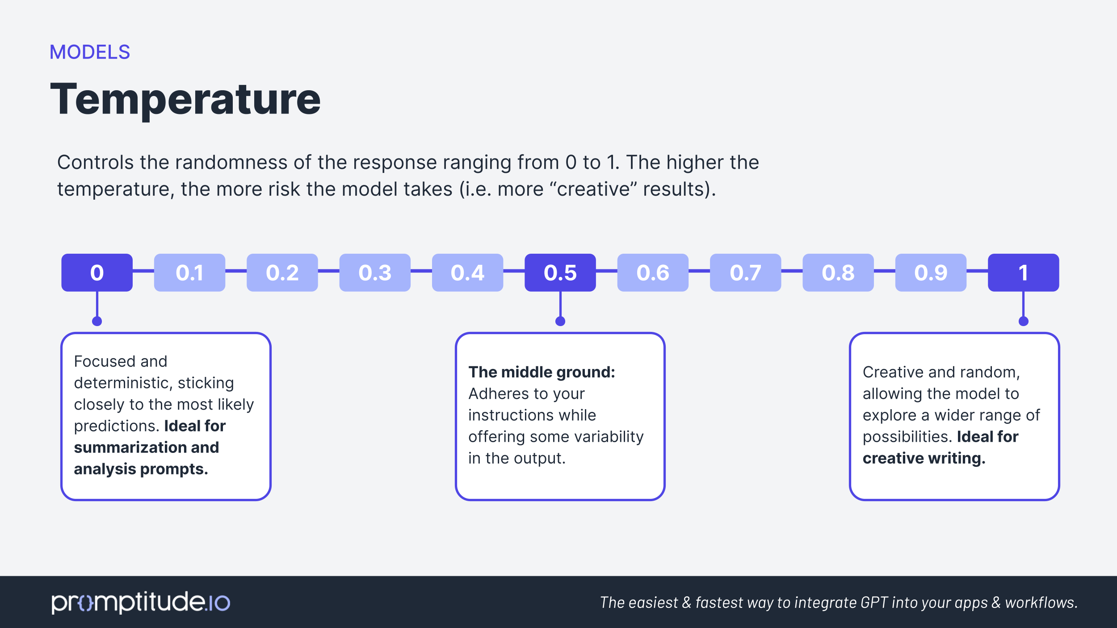

Slide 25
Retrieval Augmented Generation

Slide 26
Fine-tuning
Adapting pre-trained models to specific tasks by training on specialized datasets.
Mistake: Without fine-tuning, responses may be generic.
Solution: Train models on domain-specific data.
Example:
A chatbot fine-tuned for customer service answers queries about products accurately.

Slide 27
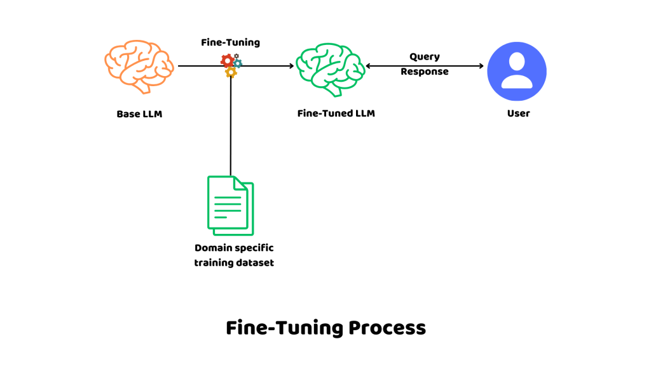

Slide 28
RAG (Retrieval-Augmented Generation)
Combining knowledge retrieval with text generation for accurate AI responses.
Example:
A legal chatbot retrieves the latest laws before answering a question.
Mistake: Without retrieval, AI might hallucinate facts.
Solution: Use external knowledge sources for factual accuracy.

Slide 29
Agentic AI

Slide 30
Agentic AI refers to AI systems that can think, plan, and take actions autonomously to achieve goals without needing constant human supervision.
Unlike traditional AI, which only responds to prompts, Agentic AI can make decisions, adapt to new situations, and act independently—just like a smart assistant that not only answers but also takes actions on your behalf.

Slide 31
Three agents specialize in different travel aspects:
1️⃣ Travel Researcher - Finds historical sites, transport, hotels, and weather
2️⃣ Budget Planner - Ensures trip stays under budget
3️⃣ Itinerary Planner - Creates a balanced 3-day plan
Multi Agent
Travel Agent
Budget Agent
Itinerary Planner

Slide 32
Python Model Deployment
Machine learning applications Mlflow,Docker
Deep Learning applications Azure AI services
NLP Applications Flask
Generative AI applications POSTMAN
LLM LangChain
Prompt Engineering Streamlit applications
RAG applications GitHUB
AI Agents Langgraph CrewAI
Cloud applications(AzureML) DataBricks

Slide 33
Quality Training
Course Certifications
Internship Certificate
Placement support
Daily Assignments
Material access life time
Class Recording access life time
Special trainings on request
24*7 Availability
Duration : 4 Months
Monday to Friday
Daily 1.5 Hour
Time: 6AM IST, 8.30pm EST
Fee: 27000 INR

